Slide 1
Chapter 5: Adversarial Search
These slides are adapted from AI Berkeley course and Russell and Norvig textbook.

Slide 2
Adversarial Search (Games)
Agents are in competitive environments (the agents’ goals are in conflict).
Types of Games
Deterministic vs. stochastic
One, two, or more players
Zero sum
The utility values at the end of the game are always equal and opposite like chess.
Perfect information (deterministic and fully-observable)

Slide 3
Game Formulation
A game can be formally defined as a kind of search problem with the following elements:
Initial State S₀ which specifies how the game is set up at the start.
Players: P={1...N}: Defines which player has the move in a state.
Actions: A: Returns the set of legal moves in a state.
Transition Function: SxA → S
Terminal Test: S → {true if the game is over, otherwise false}
States where the game has ended are called terminal states.
Utilities: SxP → R
A utility function defines the final numeric value for a game that ends in a terminal state s for a player p.
For example, in chess, the outcome is a win, loss, or draw, with values +1, 0, or 1/2.
The game solution for a player is a strategy: S → A to define its move for a given state.
An optimal strategy leads to outcomes at least as good as any other strategy when one is playing an infallible opponent.

Slide 4
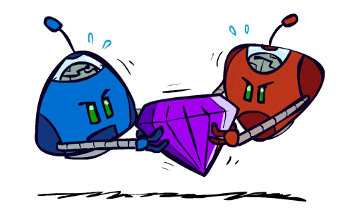
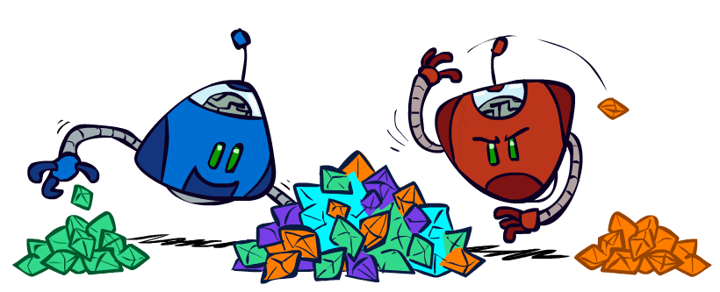
Zero-Sum Games
Zero-Sum Games
Agents have opposite utilities (values on outcomes)
Lets us think of a single value that one maximizes and the other minimizes
Adversarial, pure competition
General Games
Agents have independent utilities (values on outcomes)
Cooperation, indifference, competition, and more are all possible

Slide 5
Deterministic Zero-sum Game Setup
We first consider games with two players (MAX and MIN)
MAX moves first, and then they take turns moving until the game is over.
At the end of the game, points are awarded to the winning player and penalties are given to the loser.

Slide 6
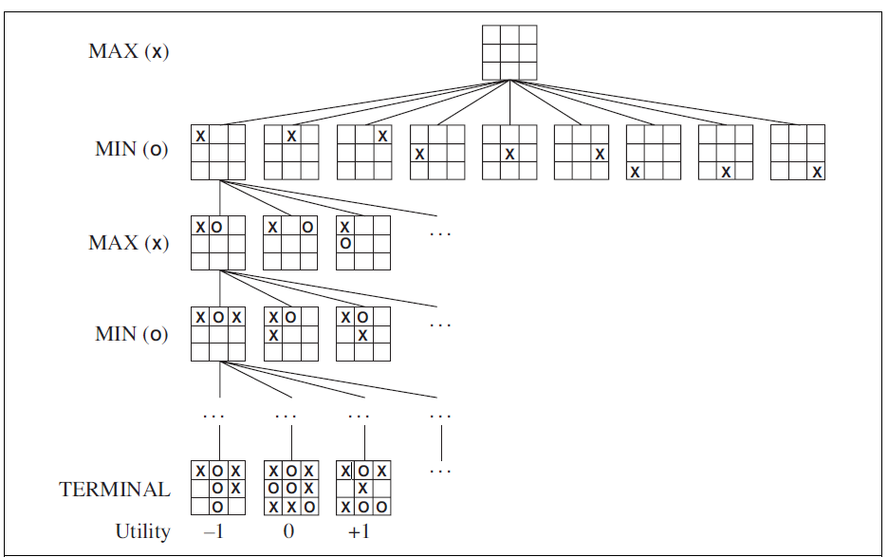
Partial Game Tree Example
Tic-tac-toe’s game tree has 9! = 362, 880
terminal nodes.
For chess there are over 10⁴⁰ nodes!!
How a player could choose an optimal move?!
Examine enough nodes to allow him to determine what move to make as we will see ☺

Slide 7
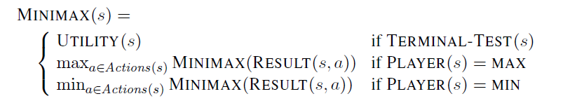
Minimax values
Given a game tree, the optimal strategy can be determined from the minimax value
of each node, which we write as MINIMAX(n).
The minimax value of a node is the utility (for MAX) of being in the corresponding state, assuming that both players play optimally from there to the end of the game.
The minimax value for a state s is calculated as:

Slide 8
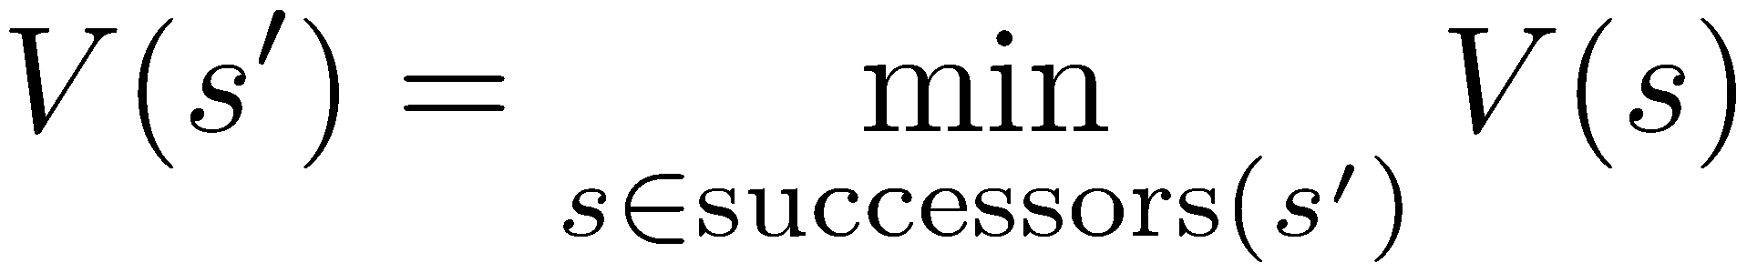
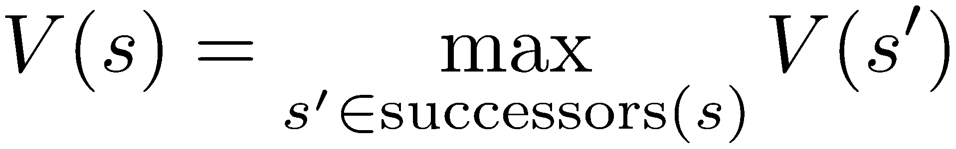
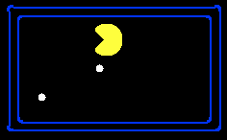

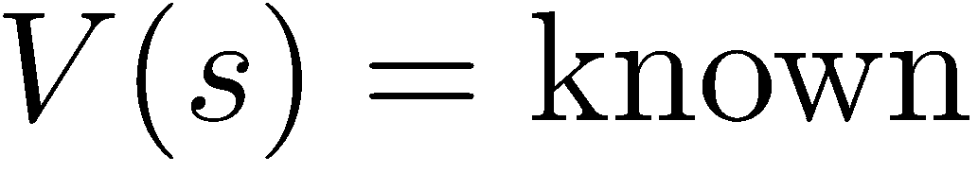
Minimax Values- Example Pacman Game
States Under Agent’s (MAX) Control:
States Under Opponent’s (MIN) Control:
-8
-5
-10
+8
Terminal States:

Slide 9
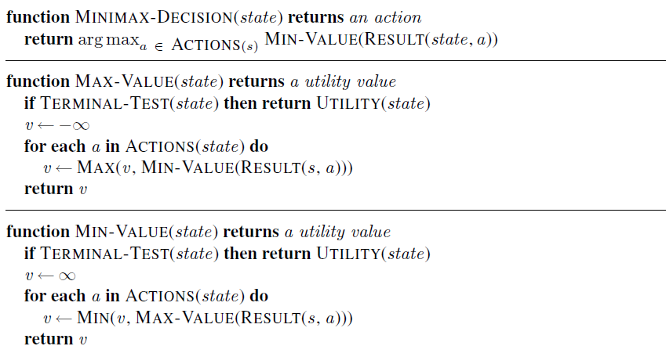
The Minimax Algorithm

Slide 10
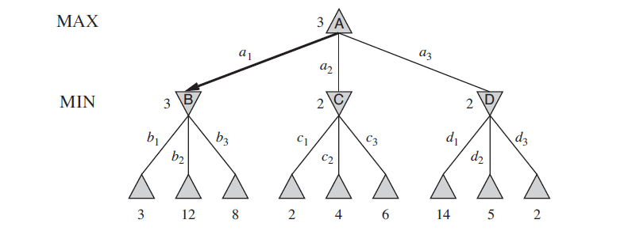
Example

Slide 11
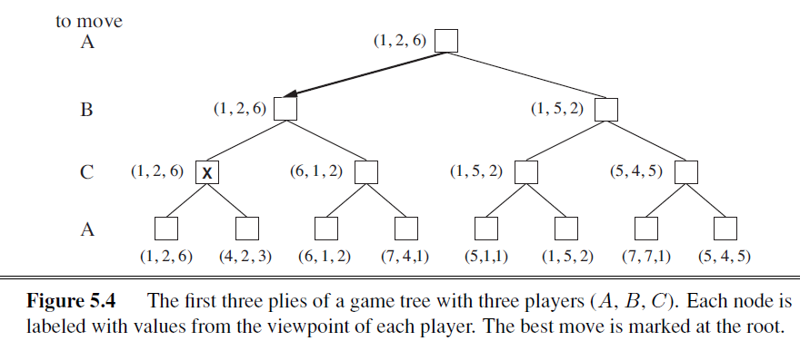
Minimax for Multi-player Games
Terminals have utility tuples.
Node values are utility tuples.
Each player maximizes its own
component.
Can give rise to cooperation and
competition dynamically.

Slide 12
Minimax Properties
Complete: Yes, if the tree is finite
Optimal: Yes, but against an optimal opponent.
Time Complexity: O(b^{m}) →For chess, b=35, m=100, infeasible time!
Space Complexity: O(bm) (depth-first exploration)
b is the branching factor (legal moves at each point), m is the maximum depth of the tree.

Slide 13
Minimax Properties (cont.)
max
min
10
10
9
100
What if min plays non-optimally?

Slide 14
Minimax Example
3
12
8
2
4
6
14
5
2

Slide 15
Pruning?
3
12
8
2
14
5
2

Slide 16
Alpha-Beta Pruning
Alpha-beta pruning computes the correct minimax decision but prunes away branches that
cannot possibly influence the final decision.

Slide 17
Alpha-Beta Pruning
General configuration
We’re computing the MIN-VALUE at some node n
We’re looping over n’s children
n’s estimate of the childrens’ min is dropping
Who cares about n’s value? MAX
Let a be the best value that MAX can get at any choice point along the current path from the root
If n becomes worse than a, MAX will avoid it, so we can stop considering n’s other children (it’s already bad enough that it won’t be played)
MAX
MIN
a
MAX
MIN
n

Slide 18
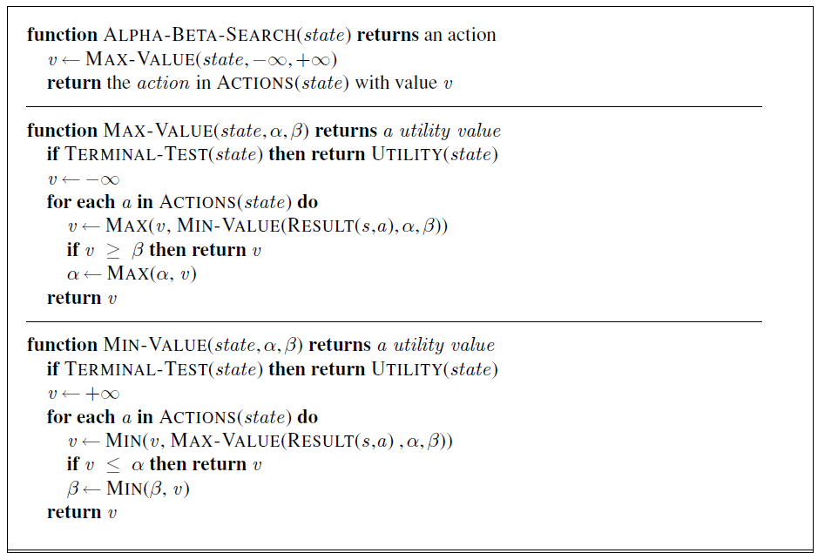
Alpha-Beta Pruning Algorithm
Notes:
Alpha–beta search updates the values of α and β as it goes along and prunes the remaining
branches at a node (i.e., terminates the recursive call) as soon as the value of the current
node is known to be worse than the current α or β value for MAX or MIN, respectively. The
complete algorithm is given in Figure 5.7. We encourage you to trace its behavior when
applied to the tree in Figure 5.5.

Slide 19
Alpha-Beta Pruning
α = the value of the best (i.e., highest-value) choice we have found so far at any choice point
along the path for MAX.
β = the value of the best (i.e., lowest-value) choice we have found so far at any choice point
along the path for MIN.

Slide 20
Alpha-Beta Pruning Properties
The alpha-beta pruning has no effect on minimax value computed for the root!
Values of intermediate nodes might be wrong
Important: children of the root may have the wrong value
Good child ordering improves effectiveness of pruning
With “perfect ordering”:
Time complexity drops to O(b^{m/2})
Doubles solvable depth!
Full search of, e.g. chess, is still hopeless…
This is a simple example of metareasoning (computing about what to compute)
max
min
10
10
0
Notes:
Perfect ordering: the minimum value for min nodes are leftmost.

Slide 21
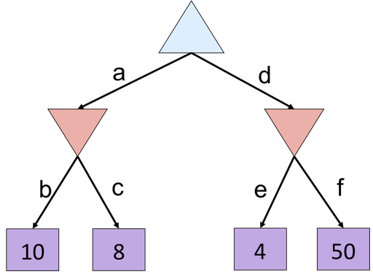
Alpha-Beta Example 1

Slide 22
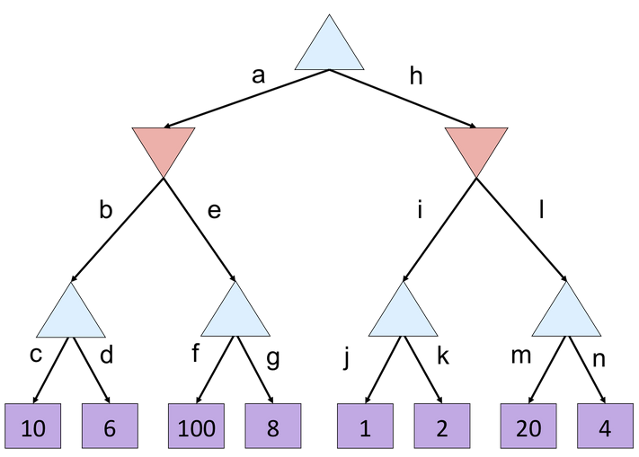
Alpha-Beta Example 2

Slide 23
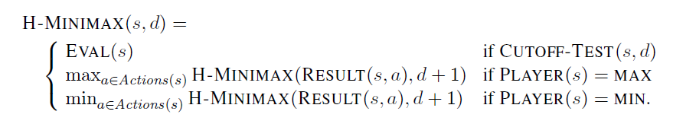
Evaluation Functions
Apply evaluation function to approximately estimate the utility at nonterminal nodes turning them into terminal leaves, and cut-off the search depth.
Alter minimax or alpha–beta in two ways:
Replace the utility function by a heuristic evaluation function EVAL, which estimates the position’s utility.
Replace the terminal test by a cutoff test that decides when to apply EVAL.
The heuristic minimax for state s and maximum depth d:
Notes:
Do you remember the heuristic functions from chapter 3 (search) in informed search?
The same concept is applied here.

Slide 24
Evaluation Functions Design
The evaluation function should order the terminal states in the same way as the true utility function: states that are wins must evaluate better than draws, which in turn must be better than losses.
The computation must not take too long!
For nonterminal states, the evaluation function should be strongly correlated with the actual chances of winning.
The evaluation function is typically a weighted linear sum of features:
e.g. For chess, f₁(s) = (num white queens – num black queens), etc.
The weights of the evaluation function can be estimated by the machine learning techniques of Chapter 18.

Slide 25
Stochastic Games
Many games has uncertainty through a random element, such as rolling dice.
A game tree in stochastic games like backgammon must include chance nodes in addition to MAX and MIN nodes.
Sources of uncertainty:
Explicit randomness: rolling dice
Unpredictable opponents: the ghosts in a pacman game respond randomly
Actions can fail: when moving a robot, wheels might slip

Slide 26
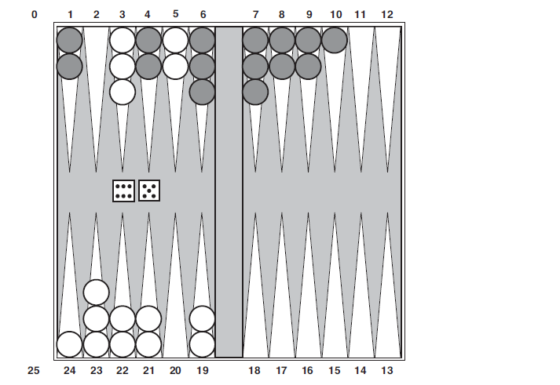
Example: Backgammon Game
Although White knows what his or her own legal moves are, White does not know what
Black is going to roll and thus does not know what Black’s legal moves will be.
That means White cannot construct a standard game tree of the sort we saw in chess and tic-tac-toe.
A game tree in backgammon must include chance nodes in addition to MAX and MIN nodes.

Slide 27
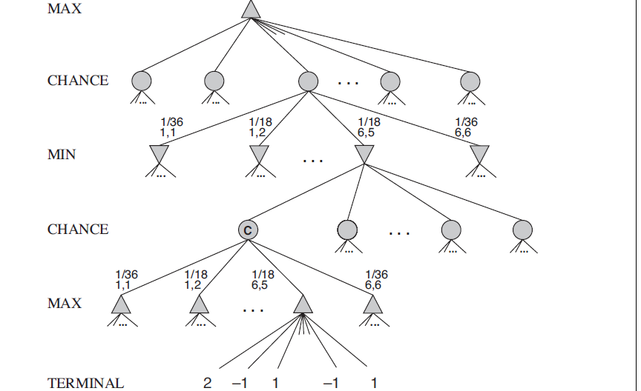
Example: Backgammon Game Tree
The branches leading from each chance node denote the possible dice rolls; each branch is labeled with the roll and its probability.
There are 36 ways to roll two dice, each equally likely; but because a 6–5 is the same as a 5–6,
there are only 21 distinct rolls.
The six doubles (1–1 through 6–6) each have a probability of
1/36, so we say P(1–1) = 1/36. The other 15 distinct rolls each have a 1/18 probability
Notes:
There are

Slide 28
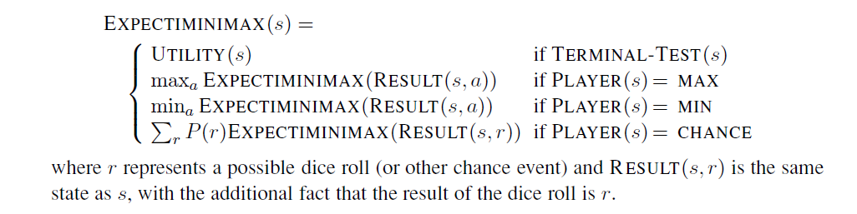
Expectiminimax Algorithm
For chance nodes, expectiminimax computes the expected value, which is the sum of the value over all outcomes, weighted by the probability of each chance action.
The terminal nodes and MAX and MIN nodes work exactly the same way as the minimax algorithm.

Slide 29
Expectimax Example
3
12
9
2
4
6
15
6
0

Slide 30
Can we do Expectimax Pruning? Why?
It might seem impossible because the value of chance node is the average of its
children’s values, and in order to compute the average of a set of numbers, we must look at
all the numbers.
But if we put bounds on the possible values of the utility function, then we can arrive at bounds for the average without looking at every number.
For example, say that all utility values are between −2 and +2; then the value of leaf nodes is bounded, and in turn we can place an upper bound on the value of a chance node without looking at all its children.
3
12
9
2

Slide 31
Utility-Scale
0
40
20
30
x²
0
1600
400
900
For worst-case minimax reasoning, terminal function scale doesn’t matter.
We just want better states to have higher evaluations (get the ordering right).
We call this insensitivity to monotonic transformations.
For average-case expectimax reasoning, we need magnitudes to be meaningful.

Slide 32
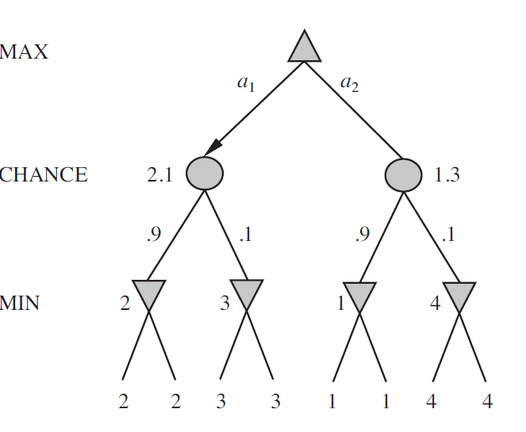
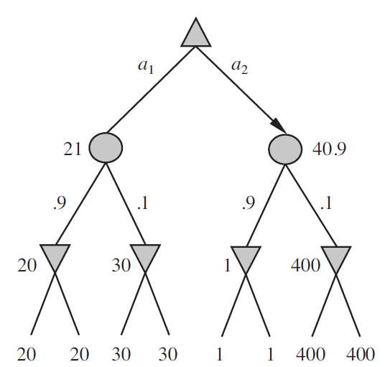
Expectimax Example
An order-preserving transformation on leaf values changes the best move!

Slide 33

Partially Observable Games
For example, card games where the opponent’s cards are unknown.
Consider all possible deals of the invisible cards; solve each one as if it were a
fully observable game; and then choose the move that has the best outcome averaged over all
the deals.
Suppose that each deal s occurs with probability P(s); then the move to play would be:

Slide 34

Partially Observable Games- Card games
In most card games, the number of possible deals is rather large.
For example, in bridge 10, 400, 600 possible deals!!
Apply Monte Carlo approximation by taking a random sample of N deals,
where the probability of deal s appearing in the sample is proportional to P(s):
As N increases, the sum over the random sample tends to the exact value.
P(s) does not appear explicitly in the summation, because the samples are already
drawn according to P(s).

Slide 35
Summary
Adversarial Search
Minimax Algorithm
Alpha beta pruning
Stochastic games
Expectimax algorithm
Evaluation functions and cutting-off the search
Partially observable games

